Slide 1


Fake Profile Detection in Social Media Platforms
Prasanna Kumar Jeyaraman
1001848479
IE 6318

Slide 2
Introduction
All social media sites have an increasing amount of bogus profiles, which is harmful on many different levels.
Social media platforms have tens of millions of fake users, which puts users' security and privacy at risk.
The Identification of fake users in these networks is crucial for improving user experience and safety.
The interest in verification of a legitimate profile is becoming more and more popular.

Slide 3
Objective
Someone's psychological well-being can be harmed by false information and impersonation.
Even though this issue primarily affects teenagers, impersonation and fraudulent accounts have a significant impact on cyberbullying, and consequently, on the psychological health and mental stability of teenagers.
The goal of this project is to create a model to recognize fake profiles on social media platforms based on the account type, followers, number of people following, date of registration, and other factors.

Slide 4
DATA identification
This dataset taken from Kaggle contains information on 786 real users and false users of the Instagram social media network, together with 12 other parameters as follows,
Profile Pic
Nums/Length Username
Fullname Words
Nums/Length Fullname
Name/Username
Description Length
External URL
Private
Posts
Followers
Follows
Fake

Slide 5
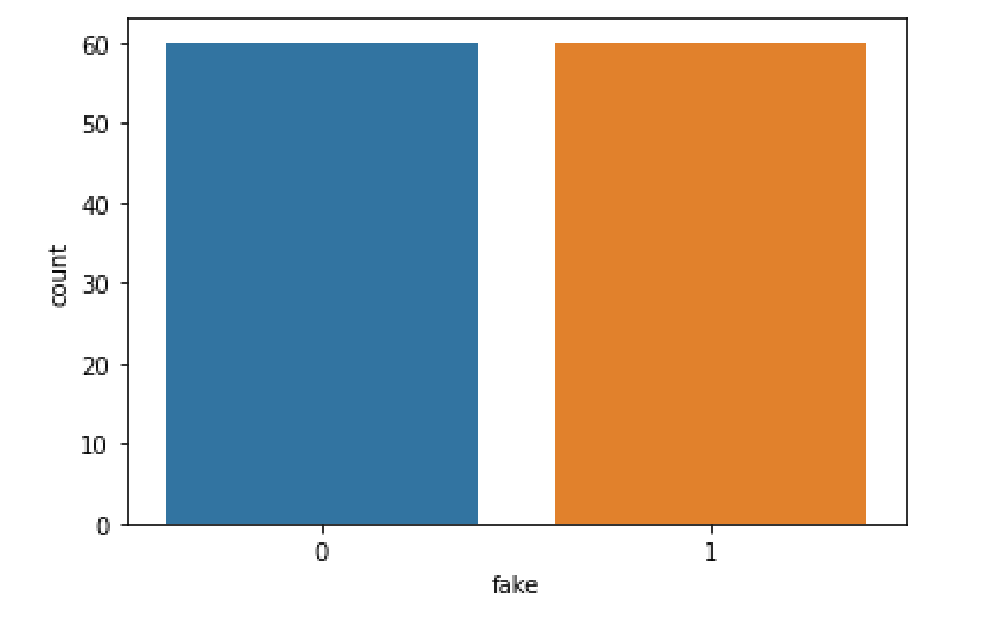
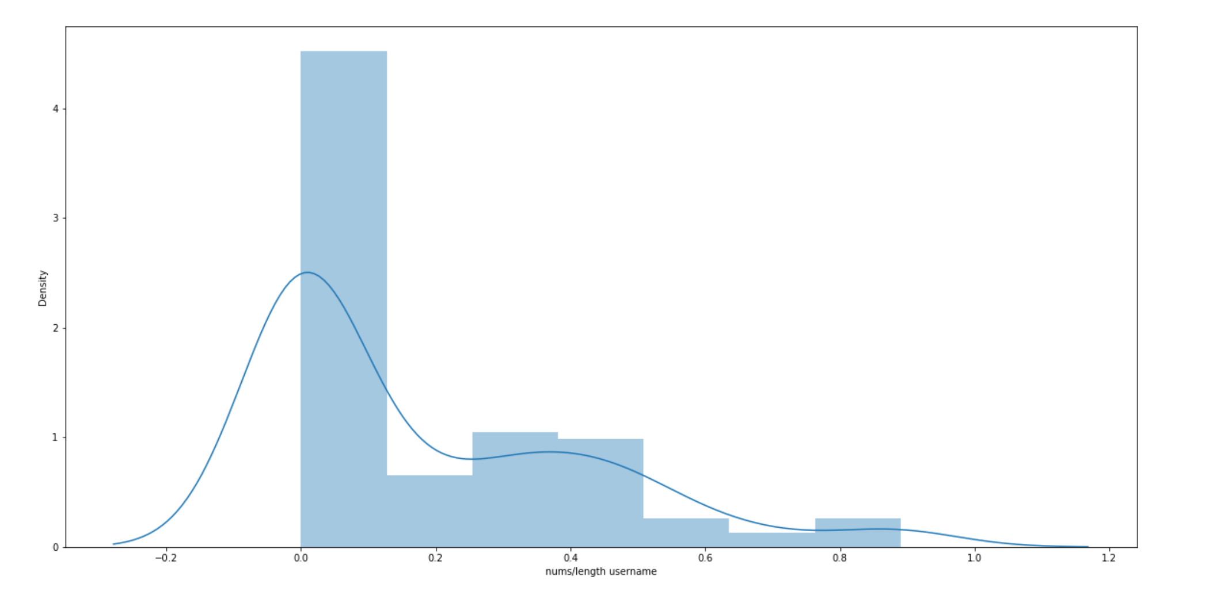
Data visualization
The panda library, which is used for data analysis and manipulation, is first imported into the code. The train_test_split function from Sklearn's model_selection module is then imported, which is used to divide a dataset into training and testing sets. Each feature in this dataset only comprises 0s and 1s, and the dataset is free of null values. Before classifying anything, I made sure the target column is balanced. I'm using a bar plot to see if the dataset is balanced or not.

Slide 6
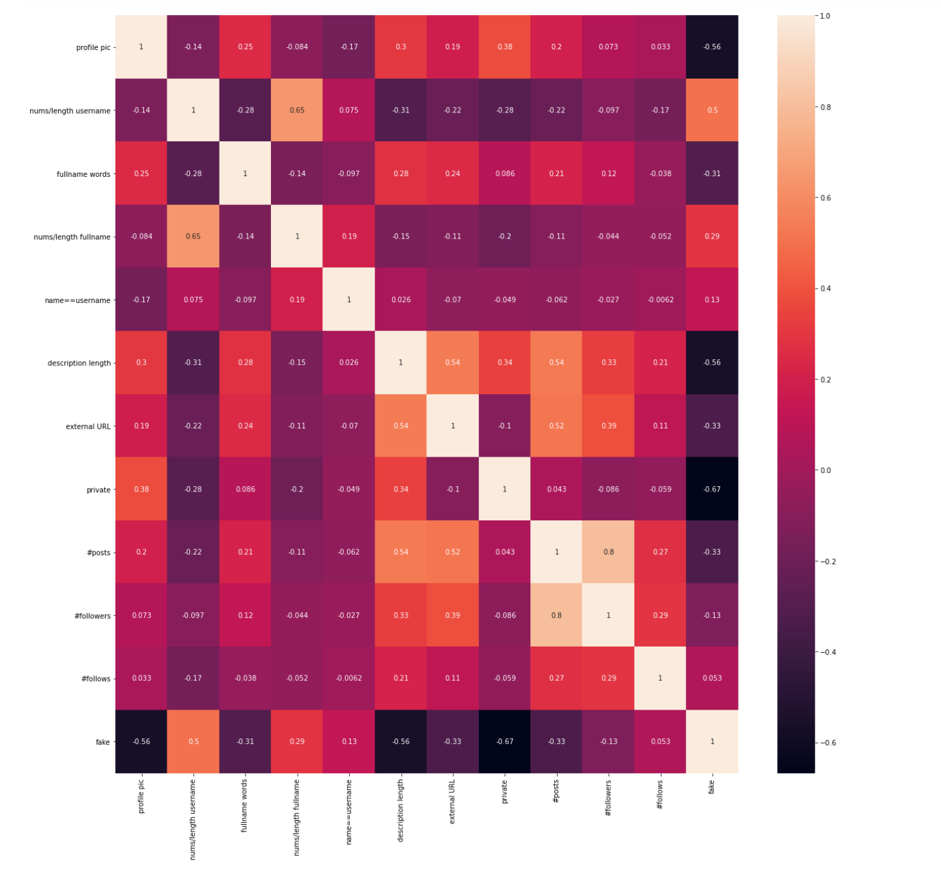
Data visualization
The heatmap in the above plot illustrates the multicollinearity of the features, which is being checked to see which features should be dropped in order to improve the accuracy of false profile deduction.
This visualization can provide valuable insights into the relationships between the different variables in the dataset, helping users identify which variables are strongly or weakly correlated with each other. This information can be used to make informed decisions about which variables to include or exclude in further analysis.

Slide 7
Classification models
We have used the following Machine learning predictive models
Gaussian Naïve Bayes
KNN with Manhattan distance

Slide 8
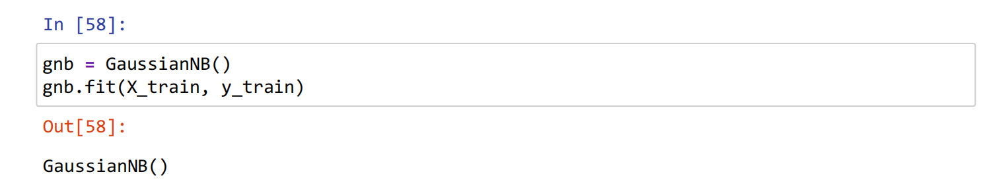
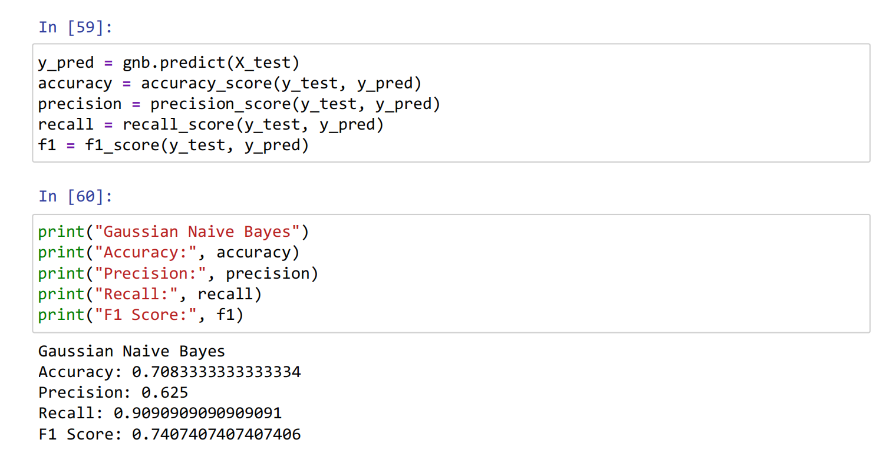
Gaussian Naïve Bayes
This code is evaluating a Gaussian Naive Bayes classifier model. The model is trained on the training set (X_train and y_train) and then used to make predictions on the test set (X_test).
The recall of the model is 0.909, which means that out of all the actual positive instances in the test dataset, the model has correctly identified 90.9% of them.
The F1 score for this model is 0.7407, which is a reasonable performance for a classifier model. Overall, this output indicates that the Gaussian Naive Bayes classifier is moderately effective at classifying instances correctly on this particular dataset

Slide 9
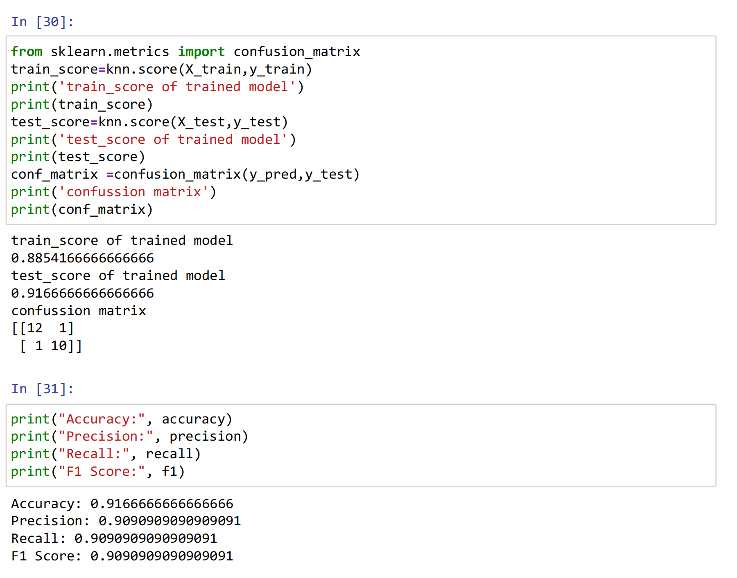
KNN with Manhattan distance
First, the code initializes a KNN classifier with 5 neighbors and a Manhattan distance metric using the KNeighborsClassifier() function from scikit-learn's neighbors module
The train_score of the trained model is 0.8854, which means that the model was able to predict the correct labels for 88.54% of the samples in the training set. The test_score of the trained model is 0.9167, which means that the model was able to predict the correct labels for 91.67% of the samples in the test set.
This indicates that the model is able to accurately identify both the positive and negative classes, with only a small number of misclassifications.

Slide 10
REsult
Prediction Model | Accuracy Rate
Gaussian Naïve Bayes | 70.8%
KNN with Manhattan distance | 91.6%
As demonstrated above, this prediction model is validated using two different classifiers. It can be seen clearly that KNN performs better than Gaussian model.

Slide 11
CONCLUSION
It is possible to train a machine learning model to estimate the possibility that a social media account is fraudulent using these and other pertinent information.
The development of an accurate fake social media account detection algorithm, however, would probably necessitate a sizable and varied dataset of actual and fake accounts, as well as rigorous feature engineering and model selection.
Additionally, it would be crucial to keep the model updated as phony accounts develop and alter over time.

